Slide 1

Why Python…?
U. Joshua,
Asst. Professor,
Dept. of CSE,
jhashuva@cvr.ac.in

Slide 2
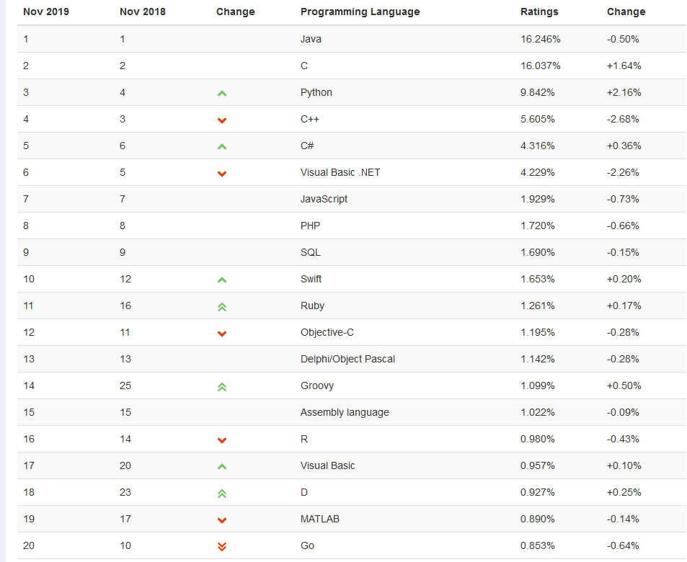
Ref: https://www.tiobe.com/tiobe-index/

Slide 3
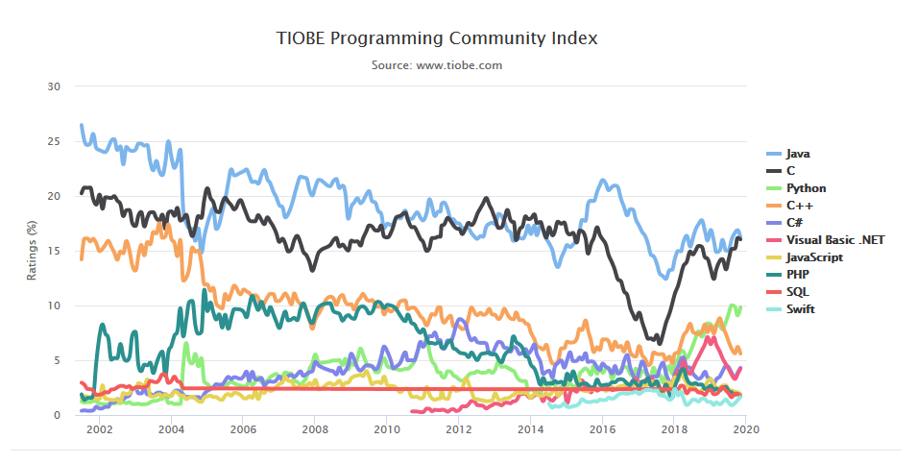
Ref: https://www.tiobe.com/tiobe-index/

Slide 4
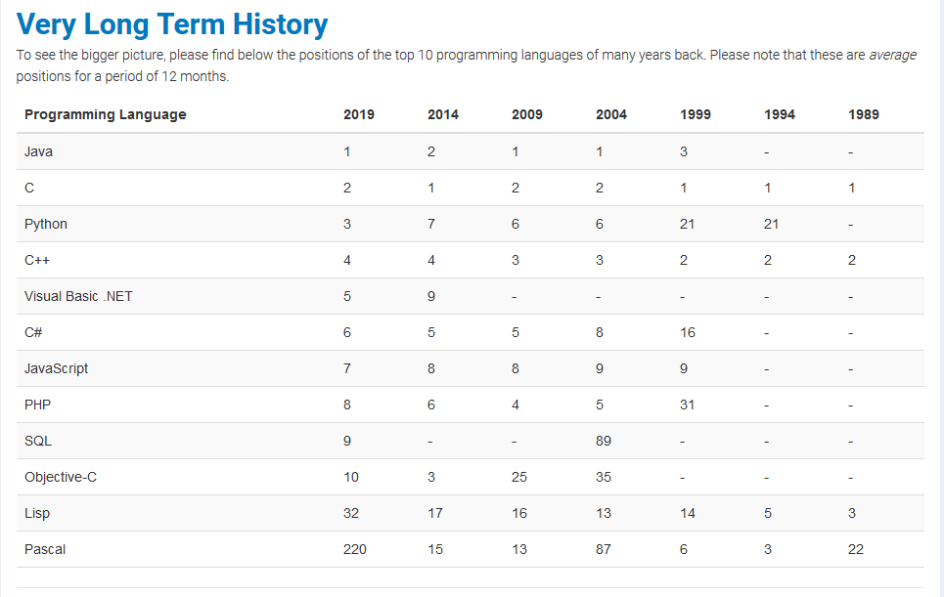

Slide 5
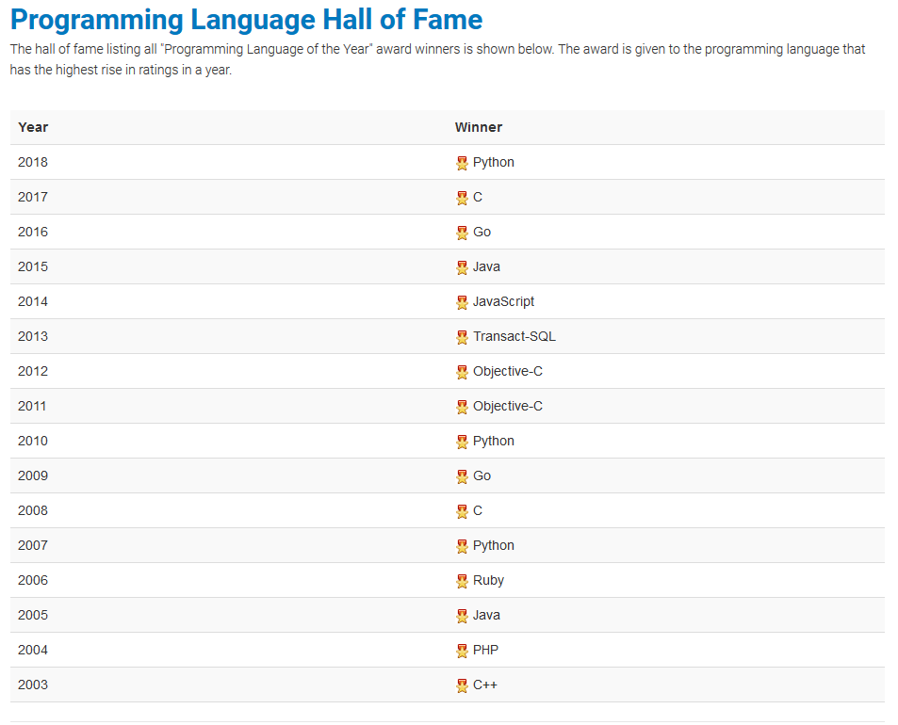

Slide 6
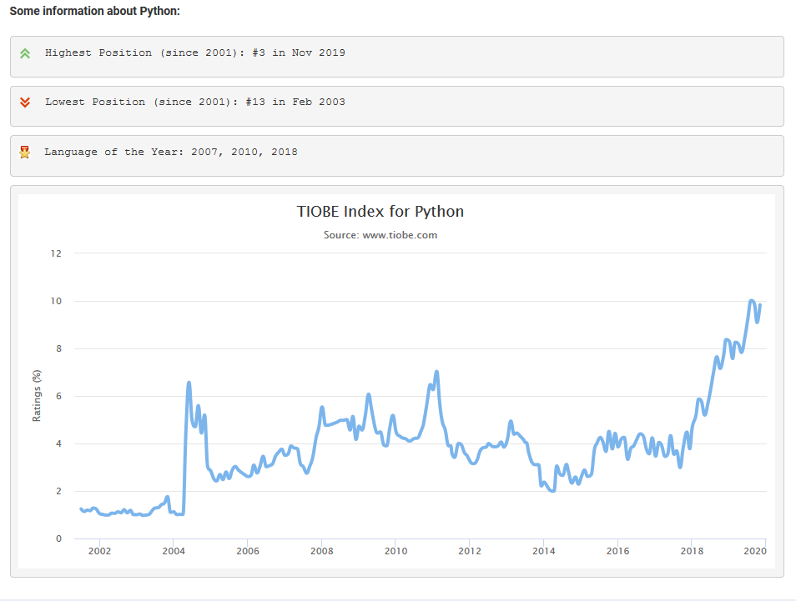

Slide 7
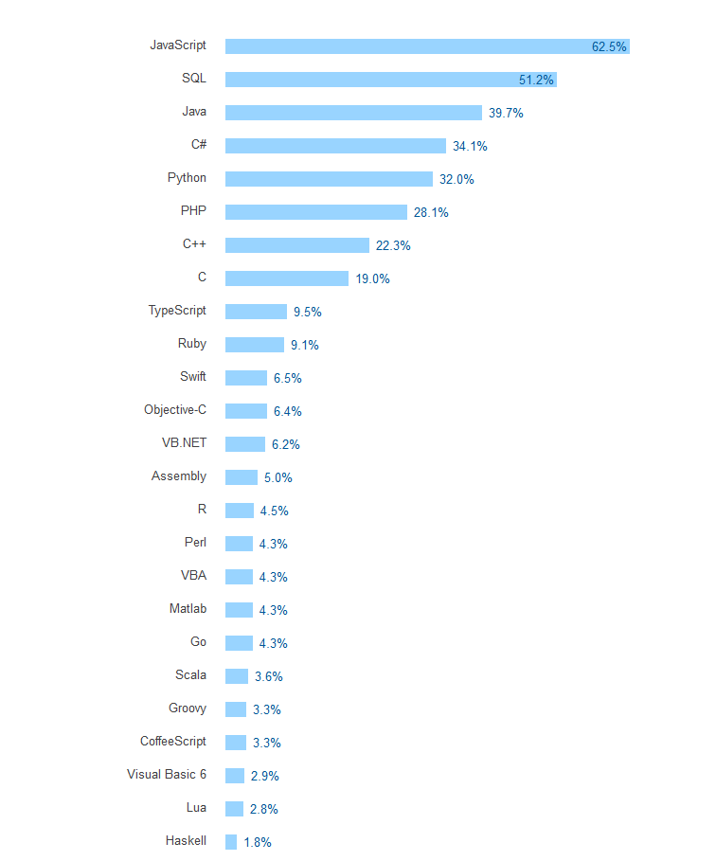
Ref: https://insights.stackoverflow.com/survey/2017

Slide 8
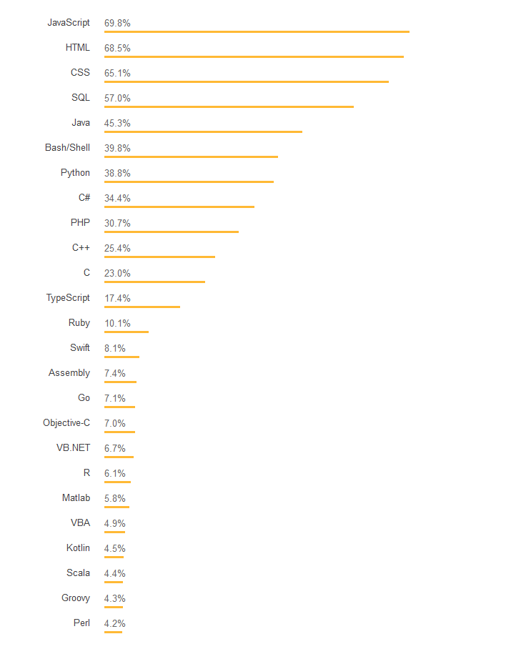
https://insights.stackoverflow.com/survey/2018#technology

Slide 9
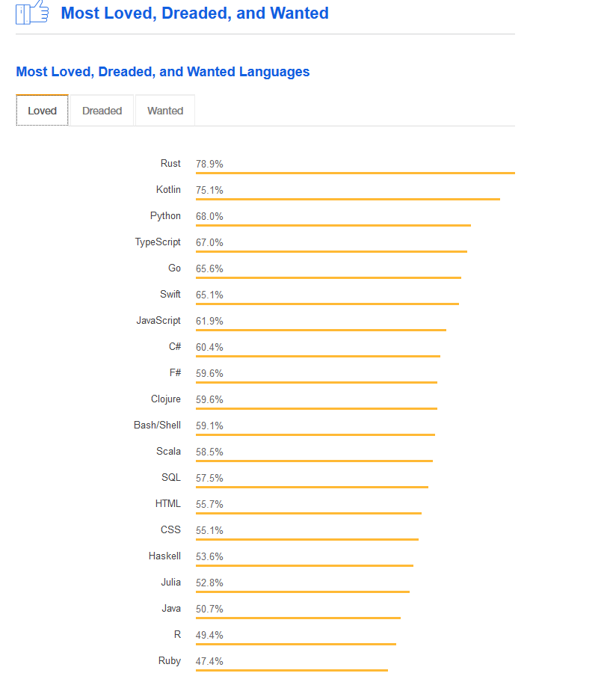
https://insights.stackoverflow.com/survey/2018#technology

Slide 10
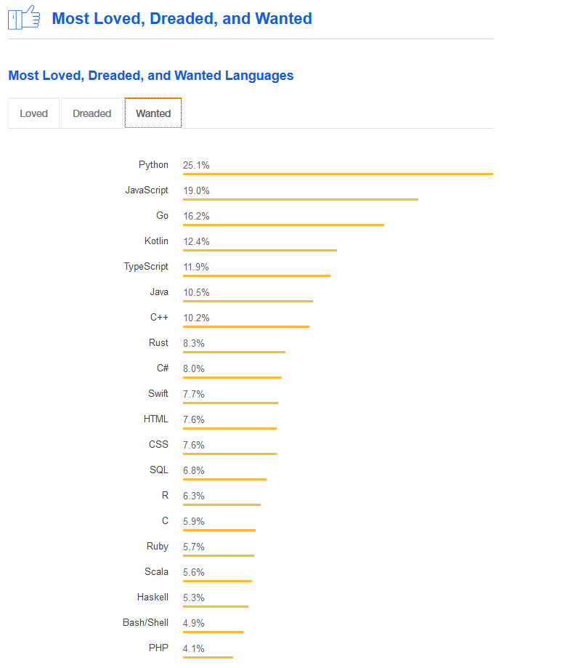
https://insights.stackoverflow.com/survey/2018#technology

Slide 11
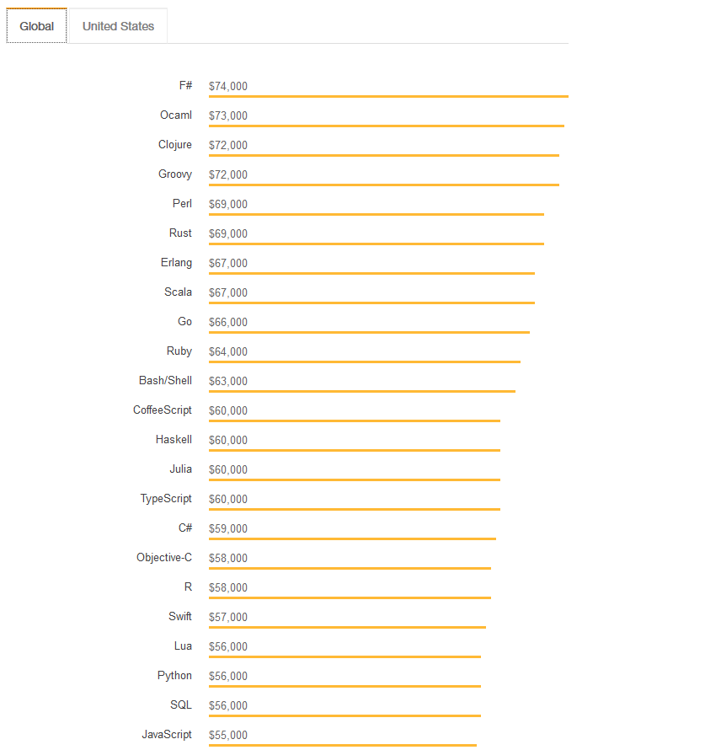
https://insights.stackoverflow.com/survey/2018#technology

Slide 12
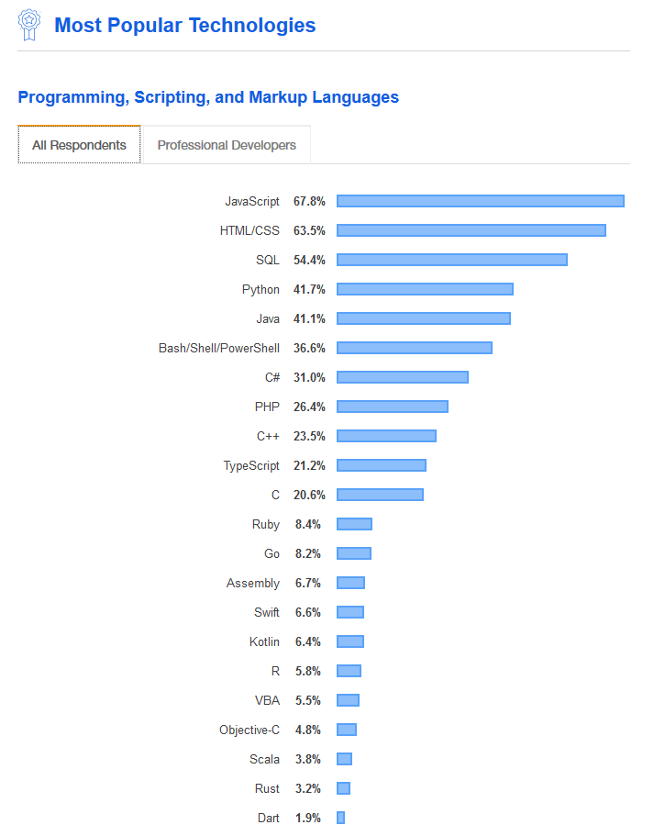
https://insights.stackoverflow.com/survey/2019

Slide 13
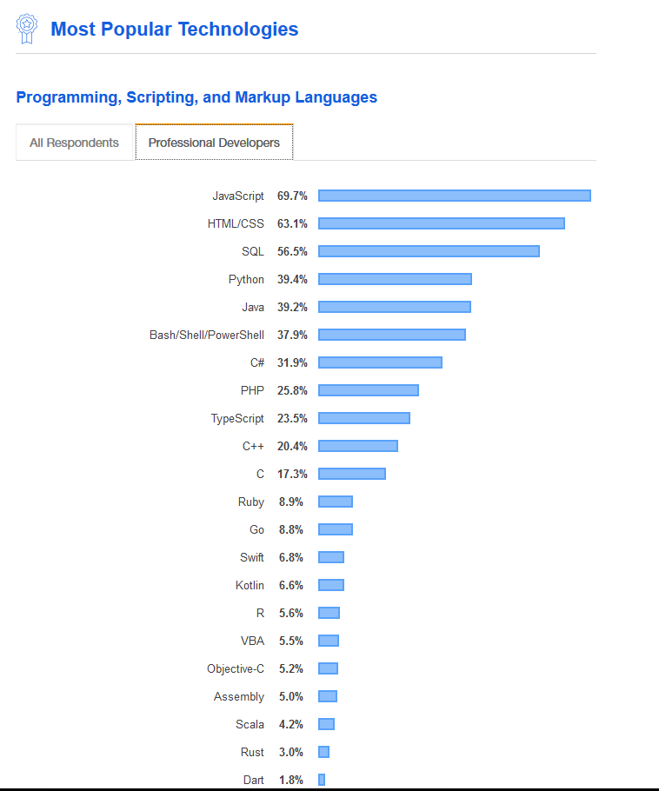
https://insights.stackoverflow.com/survey/2019

Slide 14
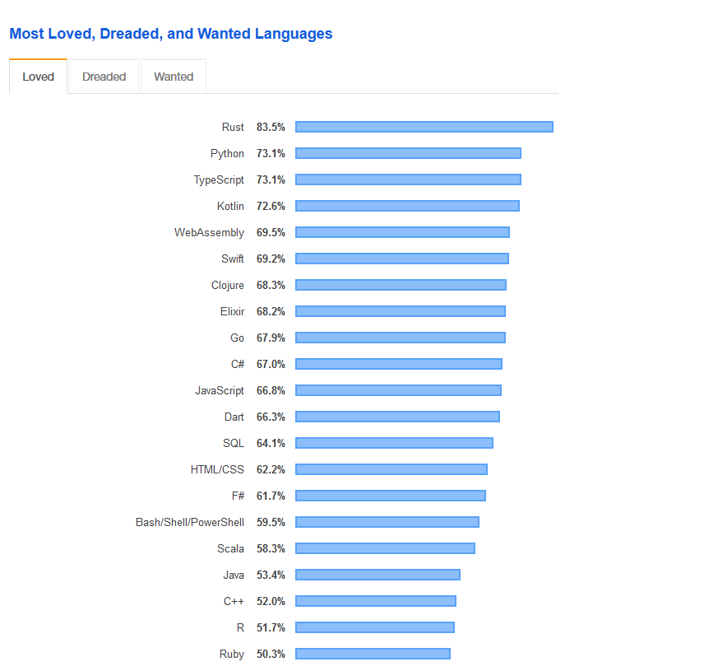
https://insights.stackoverflow.com/survey/2019

Slide 15
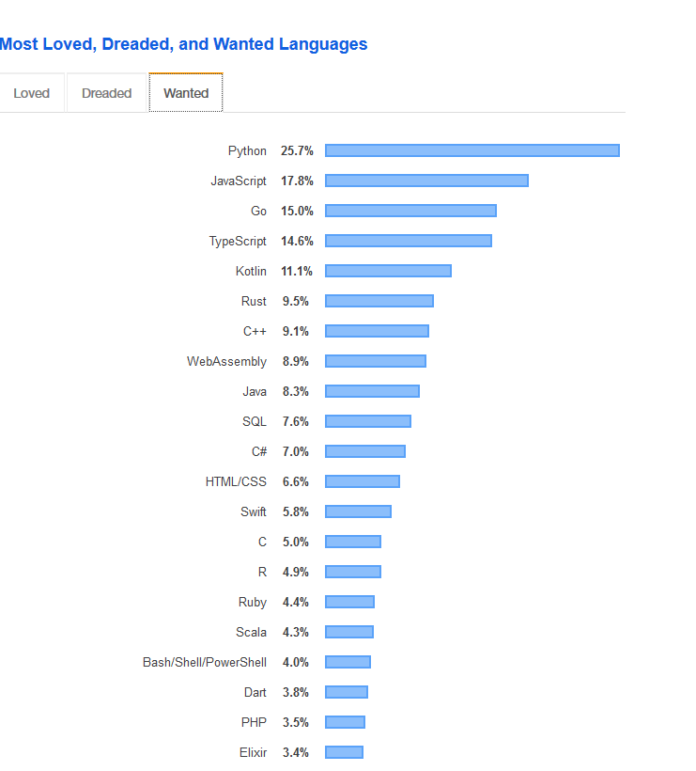
https://insights.stackoverflow.com/survey/2019

Slide 16
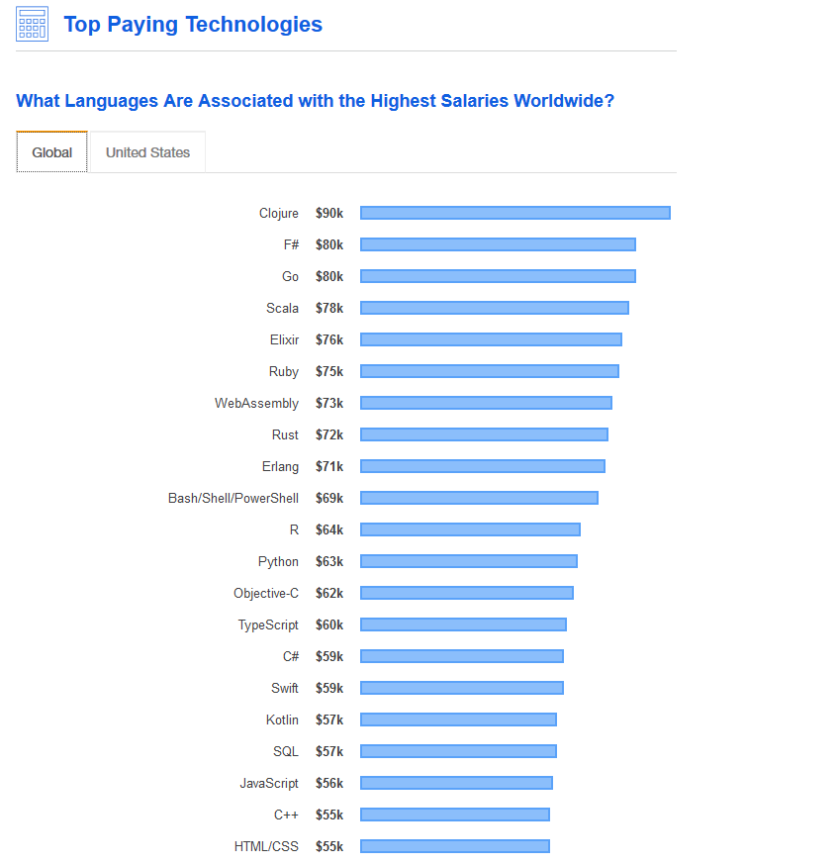
https://insights.stackoverflow.com/survey/2019

Slide 17
Summary:

